Slide 2
Fortinet
Oskar Bjärne Larsson, 2024
Notes:
Focus will be on the ”Central Nodes”.

Slide 3
Fortinet
Central Hosts
Location | Device Type | Device name | DNS | IPs | Software | Role
Azure West Europe | VM | azweufortiman | azweufortiman .mhc.molnlycke.net | 10.240.0.180 | v7.0.11 | FortiManager
 | VM | azweufortiana | azweufortiana .mhc.molnlycke.net | 10.240.0.181 | v7.0.11 | FortiAnalyzer
 | VM | az-weu-fw-FGT-A | n/a | 10.240.0.149 | 7.0.14 | HA with FGT-B
 | VM | az-weu-fw-FGT-B | n/a | 10.240.0.150 | 7.0.14 | HA with FGT-A
 | VM | az-weu-ems01 | az-weu-ems01 .mhc.molnlycke.net az-weu-ems01 .molnlycke.com | 10.240.0.12/20.86.174.247 | 7.x.x | FortiEMS Application is running on a Windows Server
Azure East US | VM | az-eus-fw-FGT-A | n/a | 10.240.128.149 | 7.0.14 | HA with FGT-B
 | VM | az-eus-fw-FGT-B | n/a | 10.240.128.150 | 7.0.14 | HA with FGT-A
Azure South Asia | VM | az-sas-fw-FGT-A | n/a | 10.240.160.149 | 7.0.14 | HA with FGT-B
 | VM | az-sas-fw-FGT-B | n/a | 10.240.160.150 | 7.0.14 | HA with FGT-A
Notes:
Total 9 Nodes.
5 in Azure West Europé
2 East Us
2 Azure South Asia

Slide 4
Fortinet Environment
Services
FortiManager
Manage PolicySets on Firewalls
Each vdom has its own Policy Set.
Upgrading Fortigates
Three Adoms
Root, IT, OT.
FortiAnalyzer
Syslog
Fortigate
Located at all Factorys and bigger Offices (US-NOR, SE-GOT).
Sales Offices does not have an Fortigate
Three Vdoms
Root, IT, OT.
Standards Models, 200F & 80F, 40F. UTP License. 200F has Inudstrial Addon License.
Azure Fortigate.
HA Deployment in each region, West Europe, East US, South Asia.
SSL-VPN (Forticlient) & IPSec Termination.
Deployed according to Fortinets Best Practices,
https://github.com/fortinet/azure-templates/tree/main/FortiGate/Active-Passive-ELB-ILB
FortiEMS, Enterprise Management Server
Managing FortiClient endpoints.

Slide 5
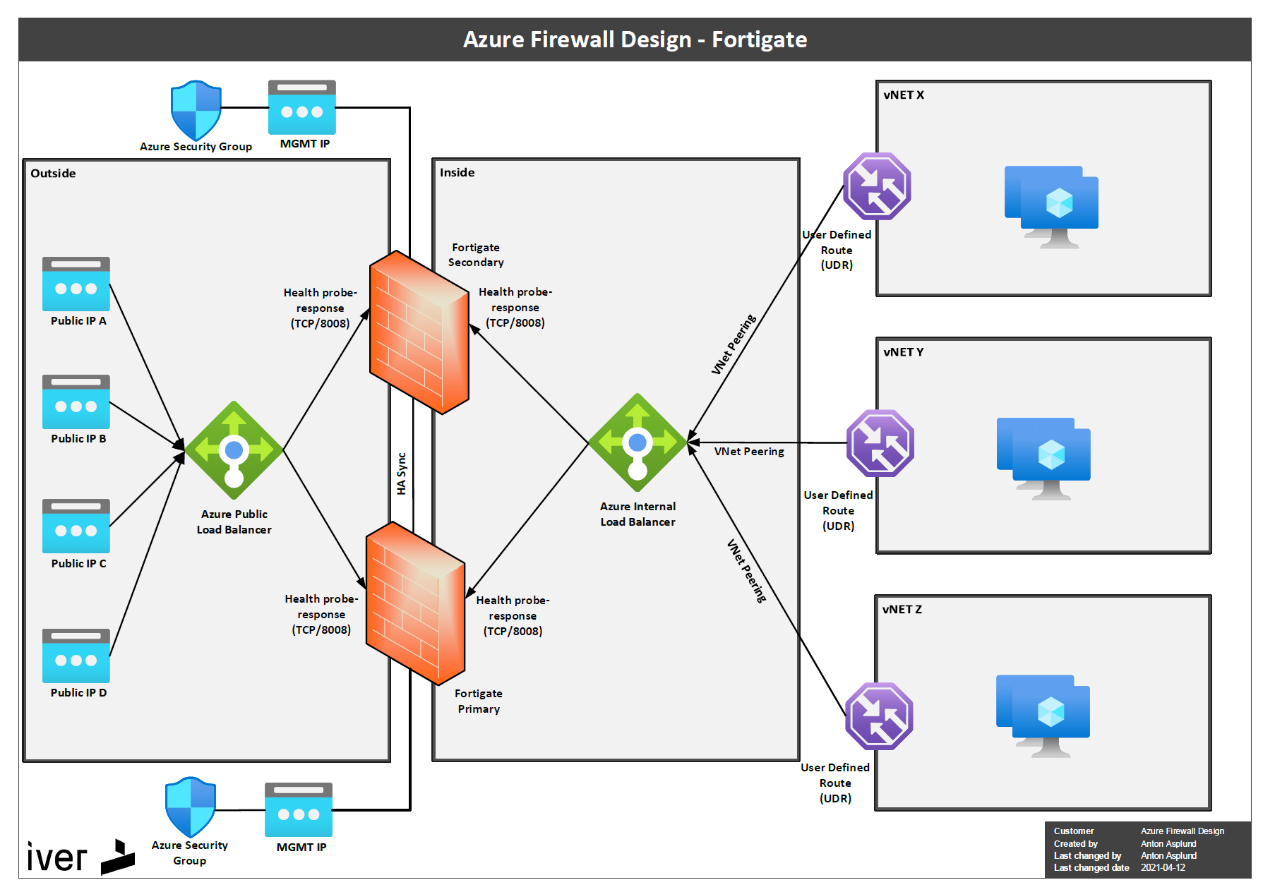
Fortigate
Azure Topology

Slide 6
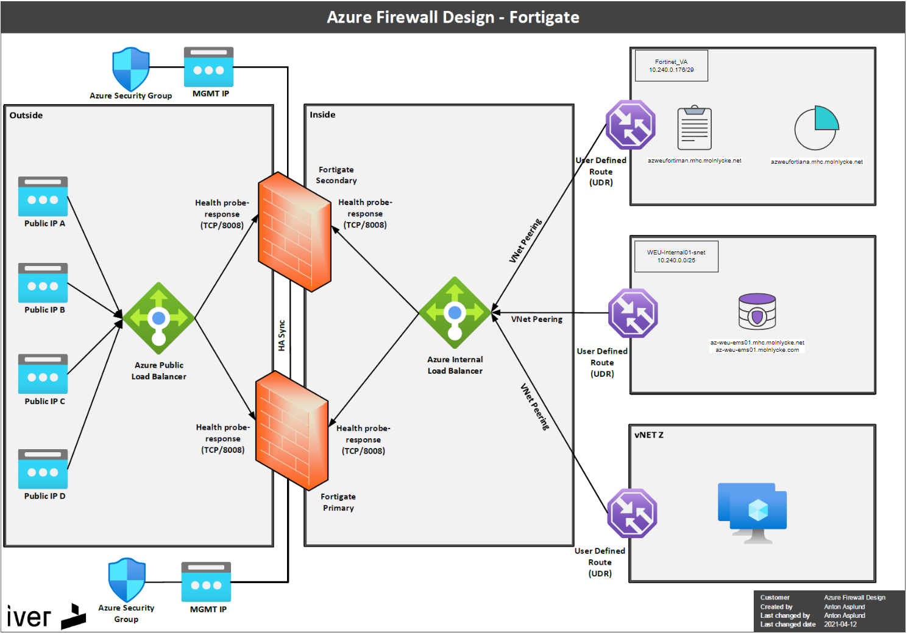
FortiManager, Analyzer, EMS
Azure Topology

Slide 7
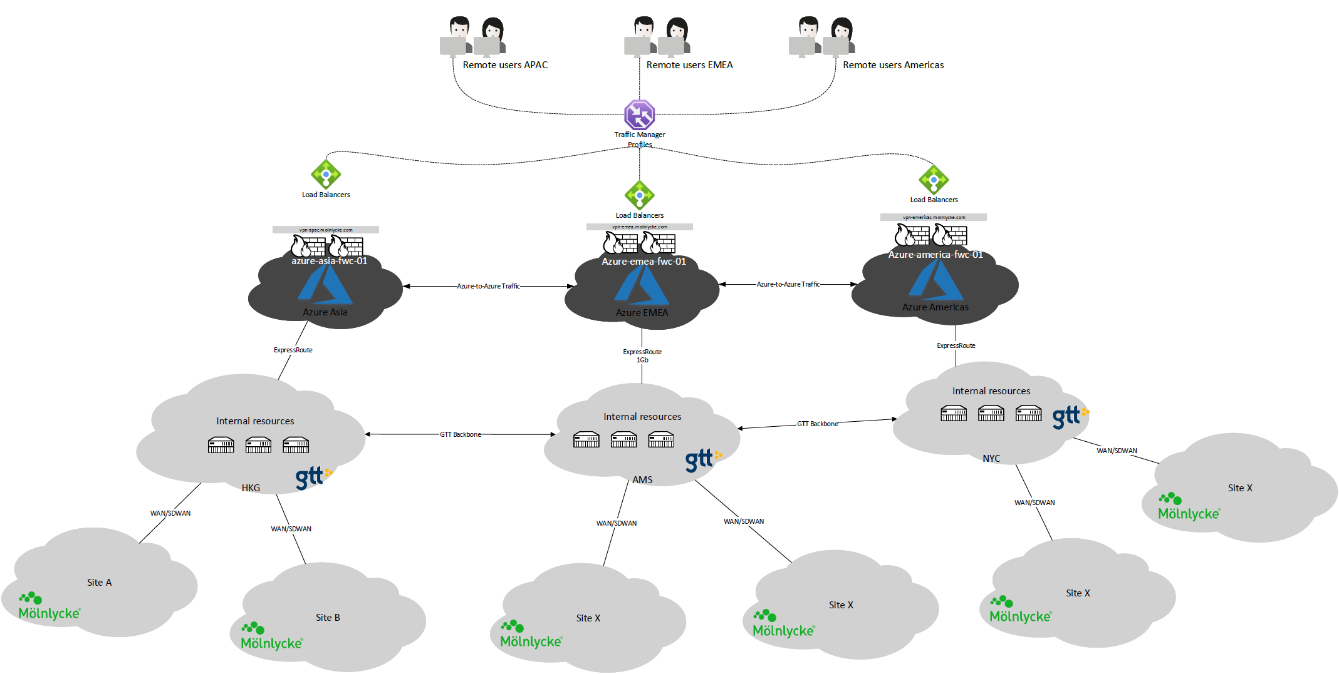
FortiClient
Traffic Flow

Slide 8
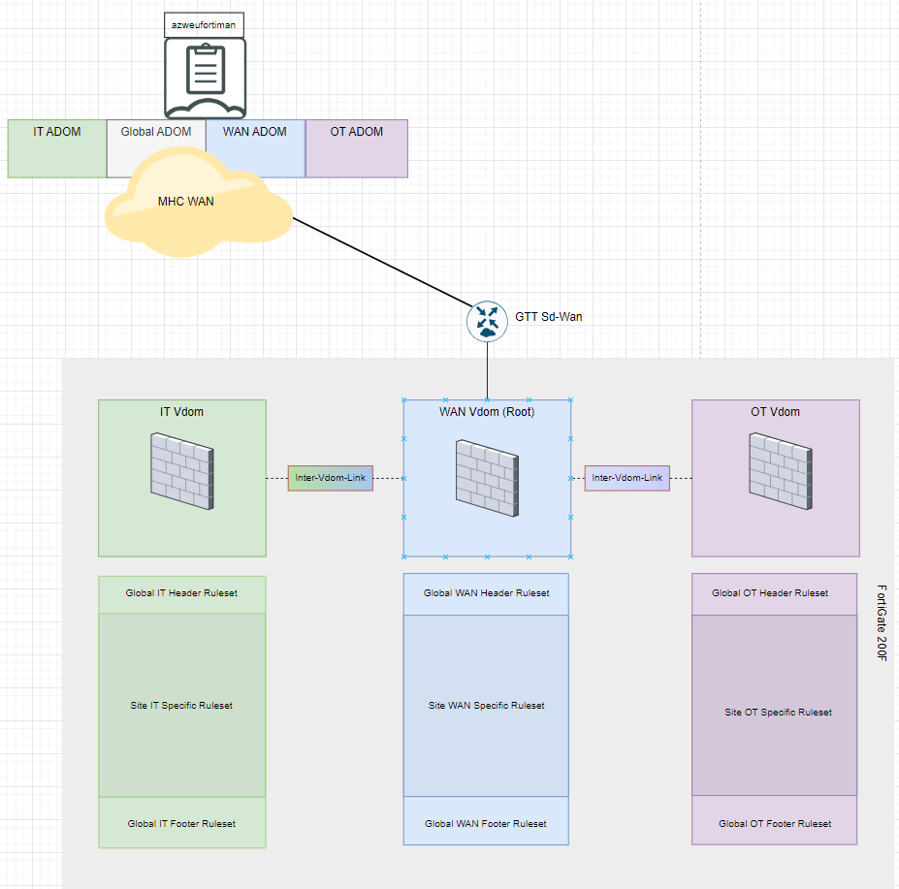
FortiManager
Adoms - UnderConstruction
Each function is assigned its dedicated ADOM, which in turn provides the opportunity to establish distinct "Global" rulesets within each VDOM (Virtual Domain).
In addition, a more concise "Site Specific" ruleset can be implemented at each site.
As of 2024-04-19 The OT Adom, and OT-Vdom is managed this way. We are currently segmenting all OT related devices from “Root” Vdom.

Slide 9
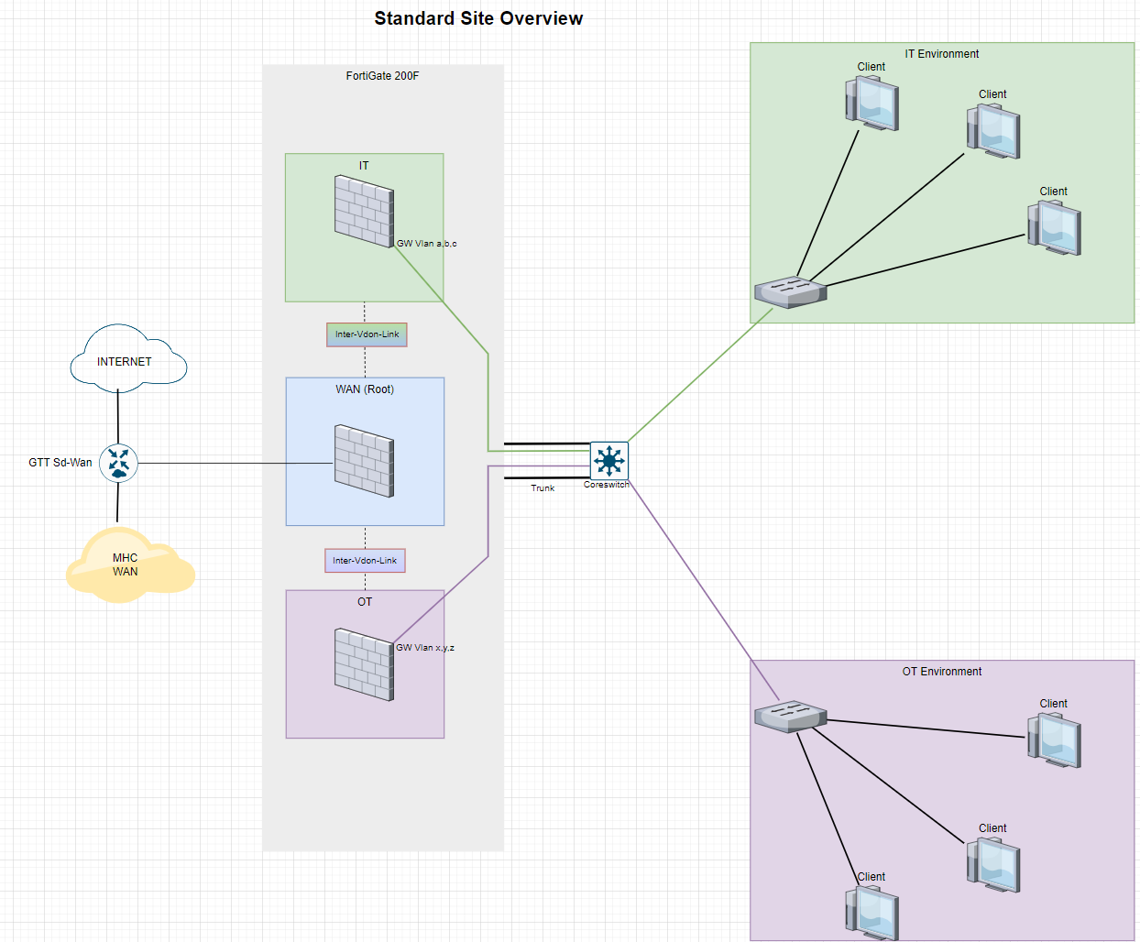
Fortigates
Typical Site - UnderConstruction
As of 2024-04-19
OT-Vdom is being implemented site by site.
IT-vdom exist at all sites but is unused.
All current traffic/interfaces are in Root-vdom, except for intefaces that has been migrated to OT-Vdom.

Slide 10
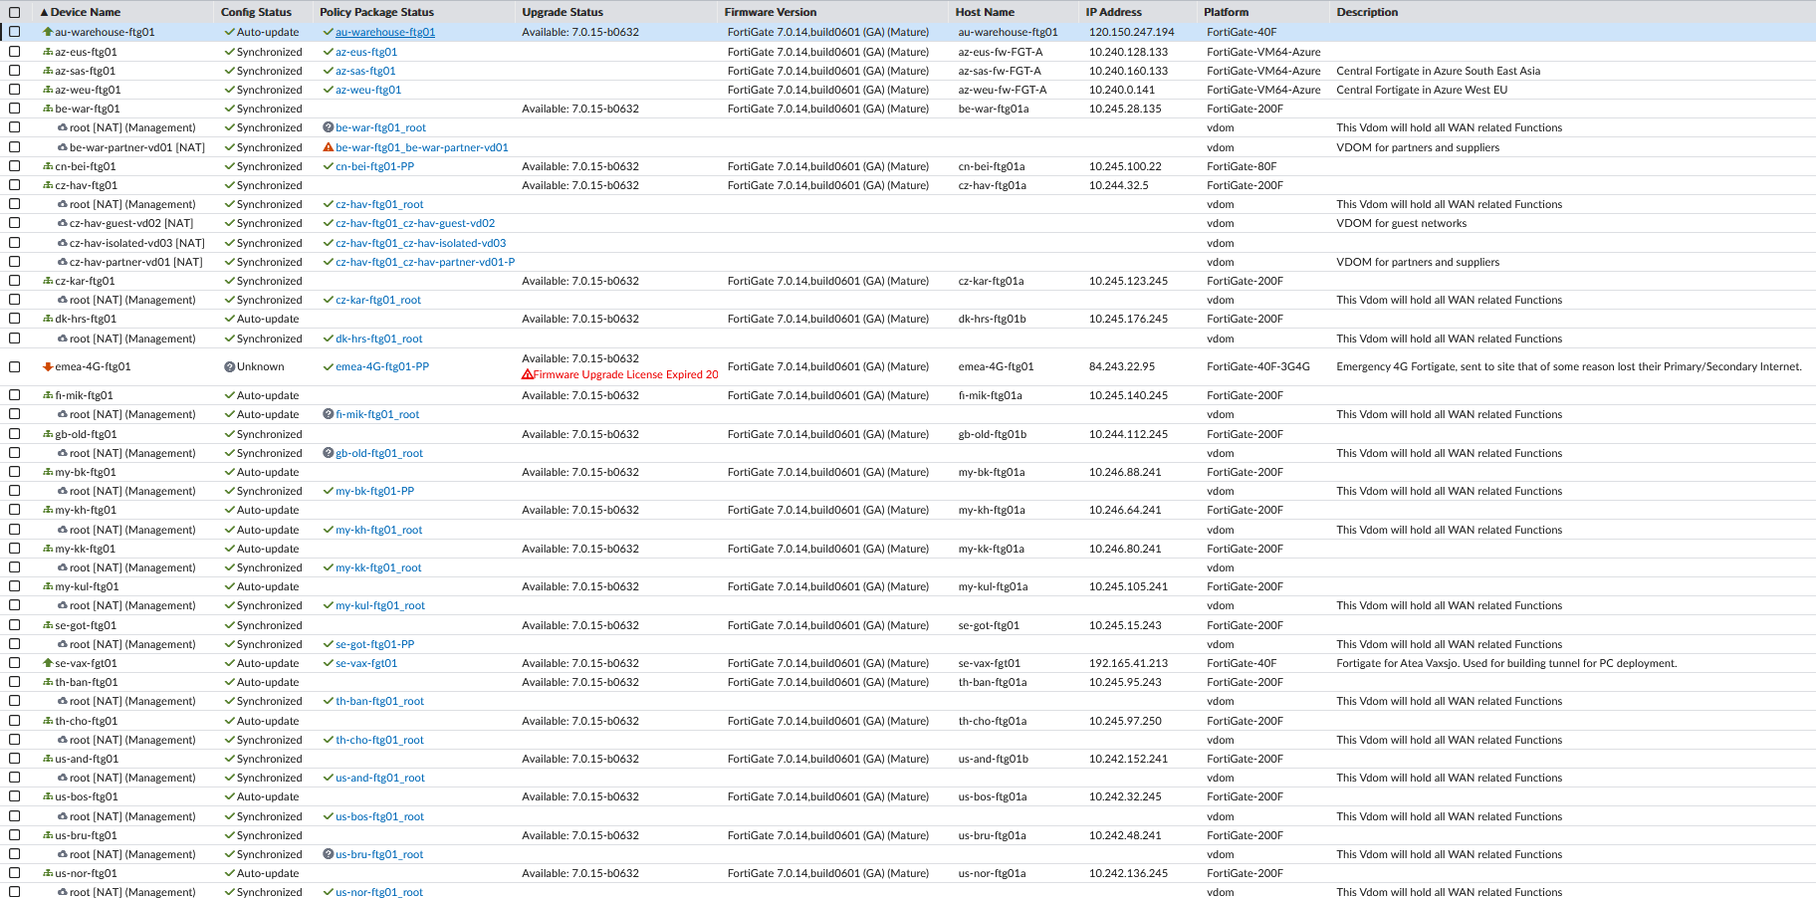
Fortigates
Current Fortigates

